Slide 1
The Downtown Troy Website

Slide 2


Hello!
We are RTAN
We are here because we all have one common problem…

Slide 3
We all are bored in Troy, NY and sick of the dining hall food

Slide 4
So we began to think…
And came up with the
Downtown Troy Website

Slide 5
So what is the Downtown Troy Website?
Our website includes many restaurants downtown and upcoming events catered to the Troy community and RPI students!

Slide 6
Gameplan
Start on the HTML by creating the pages and some of the CSS
Continue to style the html pages and CSS and have that finished by end of today
Finish the database work
Work on styling the overall look and theme of website
Any finishing touches on the website and work on presentation
Practice Presentation
SEPT 16
SEPT 28
OCT 2
OCT 12
OCT 19
OCT 26
NOV 2
NOV 11-20
NOV 27-28
DEC 1
DEC 4-5
DEC 6
Working on the HTML pages that we plan to have and basic CSS
Work on implementing the database for the users of the restaurants as well as owners
Start adding javascript features and the APIs
Continue to update website
Any finishing touches on presentation and practice
Project Due and Presentation

Slide 7

Project Requirements
Different Accounts
Company Information Storage
Events and Reviews
Deletion of irrelevant events
Filter system
Complementary recommendations
Events and Reviews
Image Gallery
Interviews

Slide 8

Technology Stack
HTML5/CSS/JS
PHP/SQL(Maria DB)
Microsoft Azure
Google APIs will be used for authentication and the map widget.

Slide 9
Users of the Downtown Troy website
Old Residents
Old residents will be able to add reviews to restaurants, and other places. On the website, users will be able to get coupons to go to places and view events that are happening in the area.
New Residents
New residents will be able to look through the different restaurants and places in Troy. Looking at the reviews they can decide where to go from there.
Small Business Owners
Business owners will be able to post events and provide coupons for users. Through Downtown Troy Website, they will be able to promote their businesses.

Slide 10
Stakeholders for the Downtown Troy website
Relatives of Troy Residents
With Downtown Troy, relatives of Troy residents will be able to see all of the different places and restaurants that Troy has to offer and know that their family members are eating well and having fun in Troy.
Real Estate Companies
Real estate agents will be able to show their clients that the neighborhood that they would be moving into has a nice atmosphere and showcase all of the different places that they can go to.

Slide 11

6 Pages of Downtown Troy

Slide 12
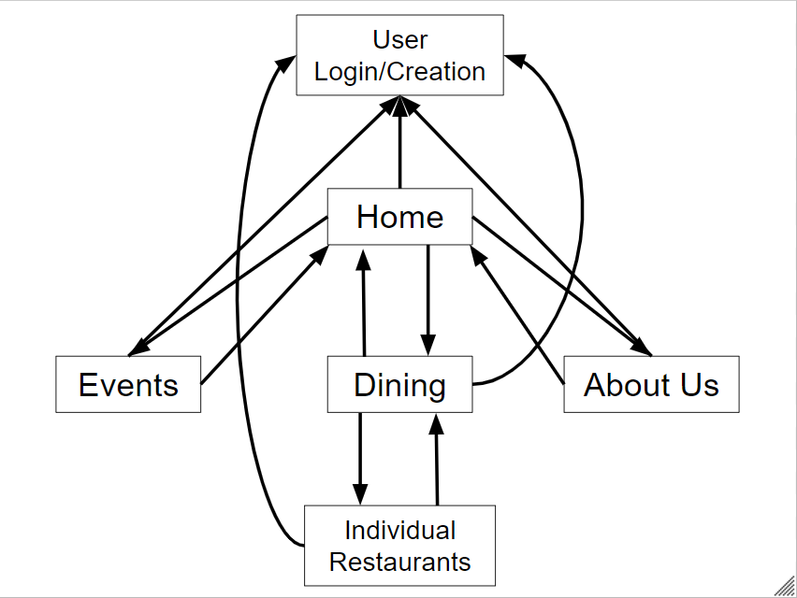
Downtown Troy Site Map
Notes:
Login/Signup Page

Slide 13
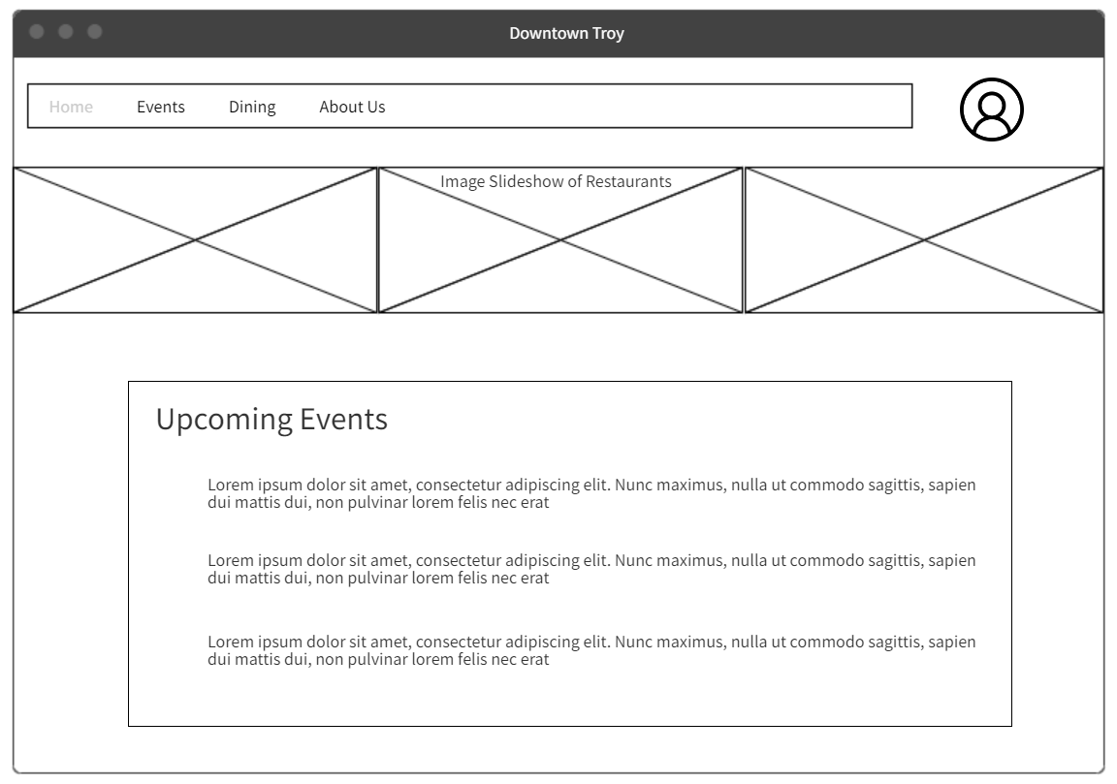
Notes:
Home Page

Slide 14
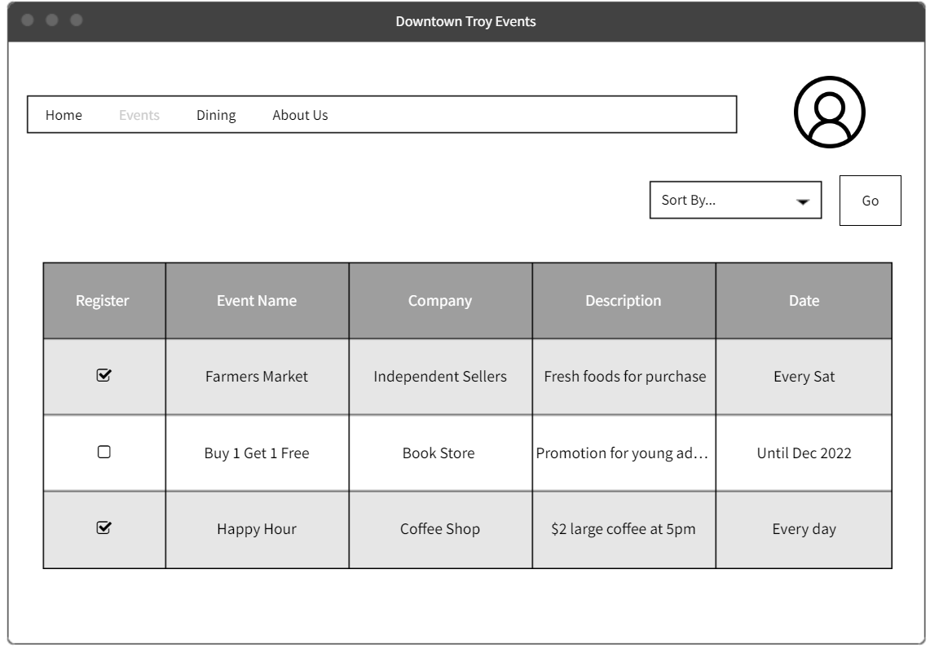
Notes:
Events Page

Slide 15
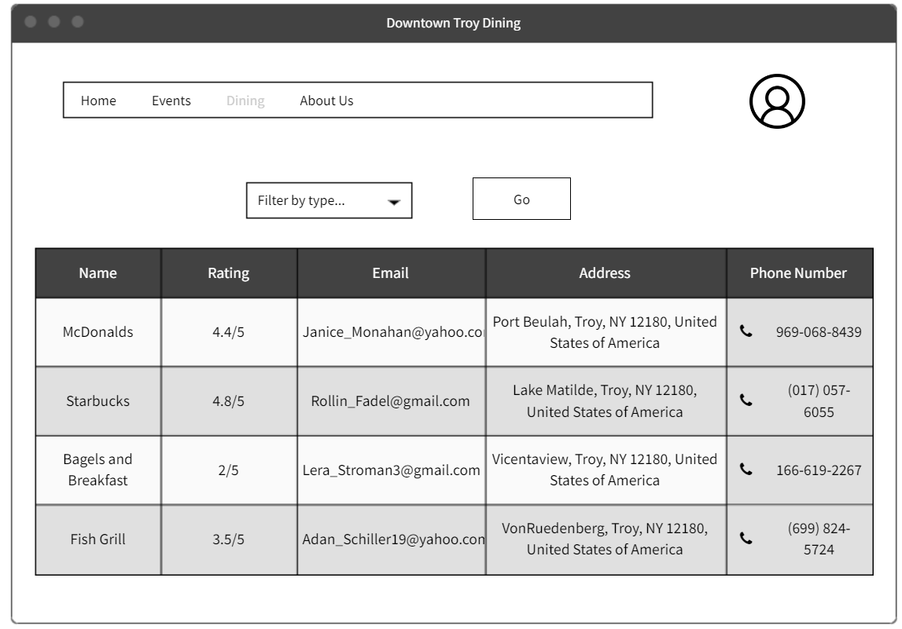
Notes:
Dining Page

Slide 16
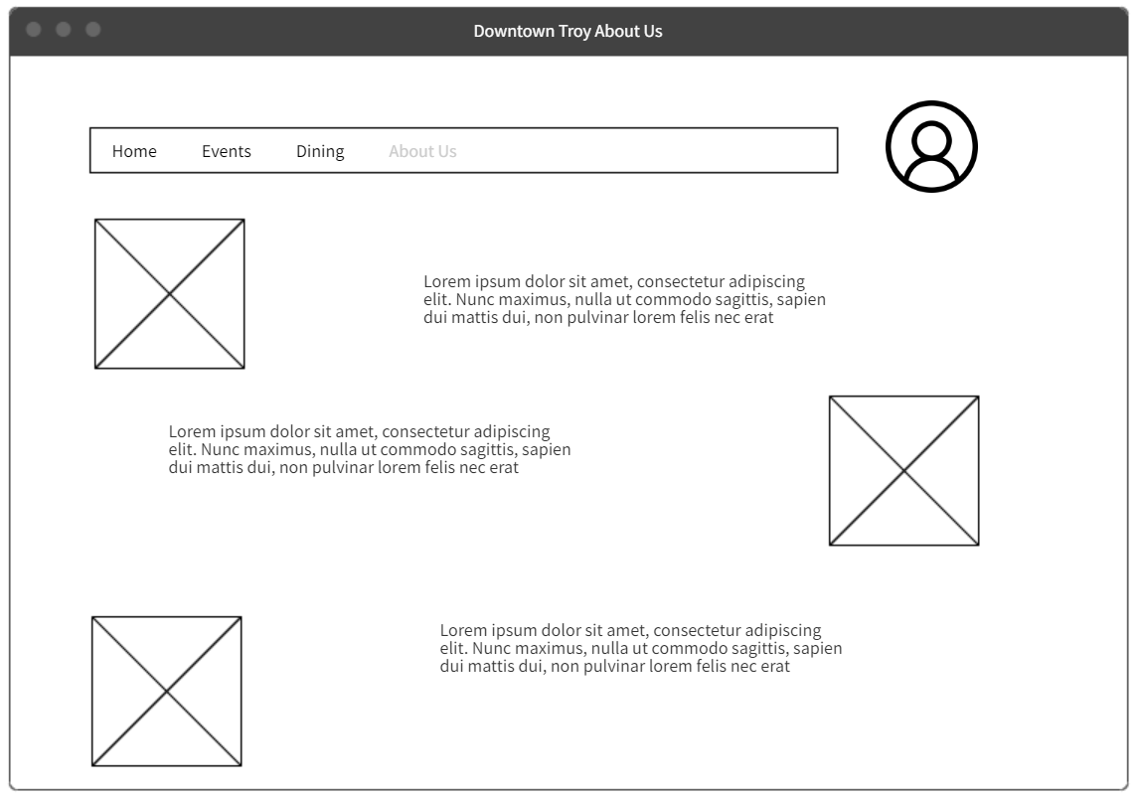
Notes:
About Us Page

Slide 17
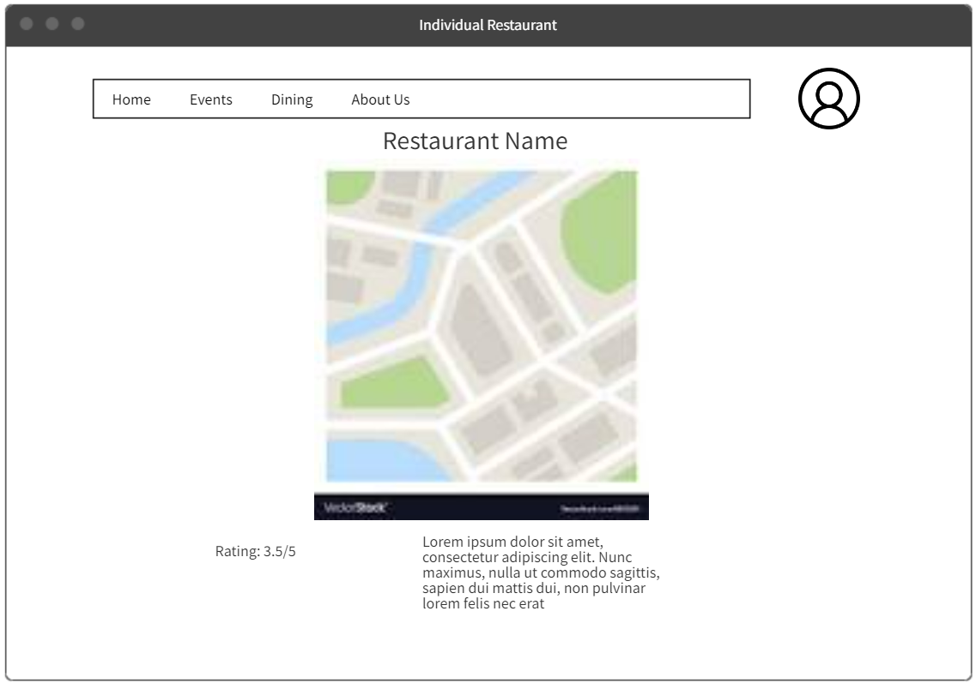
Notes:
Individual Restaurant Page

Slide 18
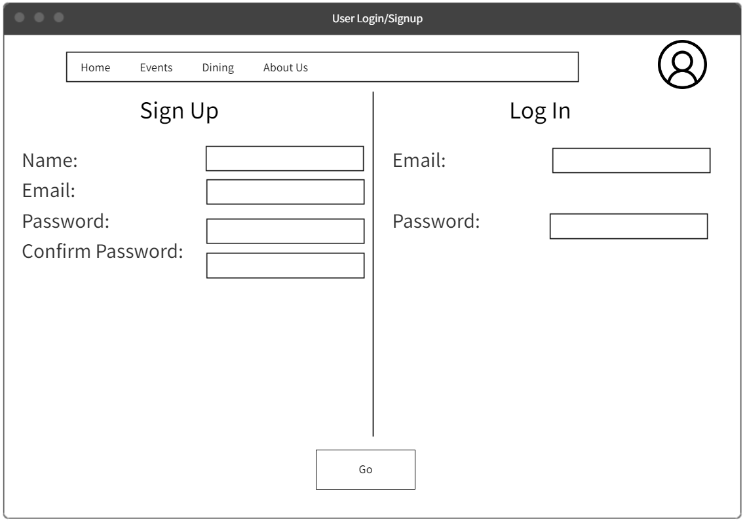
Notes:
Login/Signup Page

Slide 19

Downtown Troy Tik Tok

